Slide 1
Optimization of DualGAN for Image-to-Image Translation using Warm-Start Training
(MIT Thesis Viva Voice Examination)
Tribhuvan University
Institute of Science and Technology
Central Department of Computer Science & Information Technology
(CDCSIT TU)
Presented By: Supervised By:
Avishek Kuinkel Sarbin Sayami
Roll no: 7925002 HOD, CDCSIT TU
CDCSIT TU Date: November, 28 2025

Slide 2
ABSTRACT
This dissertation investigates a minimal-intervention strategy to enhance DualGAN for image-to-image (I2I) translation by introducing a short warm-start on limited paired data followed by standard unpaired DualGAN training, with no architectural or loss changes. The approach is motivated by practical settings where a small number of pairs co-exist with large unpaired collections (e.g., Facades labels↔photos and Day↔Night scenes). The method retains DualGAN’s U-Net generators and PatchGAN discriminators and preserves optimizer state across the transition; only the data loader switches at a predefined epoch k. Experiments on Facades and Day-Night evaluate realism and fidelity using FID, SSIM, and MSE. Warm-start consistently improves distributional realism: FID improves from 282.46 → 190.96 on Facades and 421.12 → 386.89 on Day-Night. On Day-Night, warm-start also yields higher structural similarity (SSIM 0.0793 → 0.2121) with a small MSE trade-off; on Facades, the baseline attains lower MSE/SSIM but appears less realistic distributionally. Loss curves show a stable transition at epoch k without spikes, indicating that a brief supervised anchor accelerates early alignment while preserving DualGAN’s unsupervised learning benefits. Overall, warm-start is a simple, compute-neutral enhancement that improves perceptual quality when pairs are scarce and can be tuned via k and the cycle-loss weight λ.

Slide 3
Overview
1: Introduction
1.1. Introduction
1.2. Problem Statement
1.3. Objectives
1.4. Scope and Limitations
1.5. Report Organization
2: Background Study and Literature Review
2.1. Background Study
2.2. Literature Review
3: Methodology
3.1. Description of Methodology
3.2. Data Set Description
3.3. Data Preprocessing
3.4. Description of Algorithms/ Mathematical Models
3.5. Performance/ Evaluation Metrices

Slide 4
Overview
4: Implementation
4.1. Tools and Technique
4.2. Implementation Details
5: Result and Analysis
5.1. Finding and Observations
5.2. Result Analysis
6: Conclusion and Future Recommendations
6.1. Conclusion
6.2. Future Recommendation
7:References

Slide 5
Introduction
Image-to-image translation is the task of taking images from one domain and transforming them so they have the style (or characteristics) of images from another domain.
The goal of I2I is to convert an input image from a source domain A to a target domain B with the intrinsic source content preserved and the extrinsic target style transferred.
Supervised methods usually produce better translated results than unsupervised methods on similar network structure and labeled data.
There is a need for the unsupervised Semantic Based I2I translation to reduce lots of manual tasks in image labelling and to obtain the better results in Unsupervised I2I translation.

Slide 6
Problem Statement
Training DualGAN from scratch on purely unpaired data results in slow convergence and sub-optimal translation quality on domains requiring precise structural preservation, such as label ↔ facade and day ↔ night translation. Although fully supervised frameworks like pix2pix achieve superior fidelity, collecting large paired datasets remains costly and impractical in many cases.

Slide 7
  Objectives
1. To optimize the performance of DualGAN for image-to-image translation by introducing a short warm-start pre-training phase using a limited amount of paired data.
2. To seamlessly continue standard unsupervised training on unpaired data without any architectural or loss-function modifications.

Slide 8
Scope and Limitations
Scope
This research is confined to the original DualGAN architecture and loss functions with no architectural or objective modifications.
Limitations
The method uses a limited amount of paired data for the warm-start phase and is not a fully unsupervised approach.
Computational resources are limited to Google Colab with a single NVIDIA T4 GPU, constraining the scale of hyperparameter search.
Evaluation is restricted to the Facades and Day-Night datasets only; generalization to other domains (e.g., natural photo-to-photo translation) is not studied.

Slide 9
Report Organization
Unit 1 Introduction: describes the introduction, problem statement objectives, Scope and Limitation.
Unit 2 Background Study and Literature Review: describes the Background Study and Literature Review.
Unit 3 Methodology: describes the methodology, data set, data preprocessing, Algorithms/mathematical models and performance/evaluation metrics.
Unit 4 Implementation: describe about tools and technique, implementations details.
Unit 5 Result and analysis: describe about finding and observations, result analysis.
Unit 6 Conclusion and Future Recommendations: Describe about Conclusion and Future Recommendations.

Slide 10
Background Study and Literature Review
The concept of image to image (I2I) interpretation has experienced noteworthy advancement, getting to be a foundation within the field of computer vision.
I2I translation's core objective is to convert a picture from one space to another while protecting its inborn substance, an errand that has seen significant refinement and development over a long time.
cGANs are flexible and general-purpose arrangements for a wide range of I2I interpretation issues.
WGAN has enhanced our understanding of the challenges with traditional GANs, such as poor convergence and mode collapse, and has offered solutions to improve the quality of the generated outputs.
DualGAN presents a bidirectional learning model for image-to-image translation, drawing inspiration from dual learning techniques in natural language processing and adapting them for the image translation field

Slide 11
Literature Review
DualGAN is a pioneering unsupervised I2I translation framework that operates without any paired data. Its key advantage lies in its ability to train solely on unpaired collections while achieving competitive results on various tasks [1].
Conditional GANs (cGANs), particularly pix2pix, extended GANs to supervised I2I translation by conditioning both the generator and discriminator on input images. While highly effective, pix2pix requires large paired datasets, limiting its applicability in data-scarce scenarios [2].
To address training instability in original GANs, Wasserstein GAN (WGAN) [3] replaced Jensen-Shannon divergence with the Earth Mover distance, enforced via weight clipping or gradient penalty. This modification significantly improves convergence and reduces mode collapse, influencing subsequent unsupervised translation models [3].

Slide 12
Methodology
Description of Methodology.
The main stages are:
Data Acquisition: Images are collected from benchmark semantic image-to-image (I2I) datasets covering two translation tasks: facades, and day-night scenes.
Data Preparation: All datasets are preprocessed to a consistent resolution, normalized pixel range, and standard partitioning into training/validation/test sets. For training, the data are also organized into paired subsets (for warm-start) and unpaired subsets (for fully unsupervised DualGAN learning).
Model Architecture (DualGAN): A DualGAN framework is adopted with two generators (A→B, B→A) and two discriminators (for Domains A and B). The model is trained using adversarial and cycle-consistency objectives to learn bidirectional mappings between domains.
Phase 1 – Warm-Start Training (Supervised): In the first phase, the DualGAN model is trained on paired examples (A, B). This supervised signal provides an initial alignment between domains and improves stability of subsequent unsupervised training.

Slide 13
Phase 2 – Unsupervised Continuation (DualGAN): After the warm-start, training continues on larger unpaired datasets from each domain using the standard DualGAN objective. Network weights, optimizer state, and hyperparameters are preserved; only the data loader is switched from paired to unpaired samples.
Hyperparameter Tuning: Key hyperparameters (e.g., batch size, n_critic, cycle-loss weight λ, transition epoch k, effective data size, dropout rate) are tuned using validation performance to obtain an empirically optimal configuration of the semi-supervised DualGAN.
Model Evaluation: The trained models are evaluated using Mean Squared Error (MSE), Structural Similarity Index (SSIM), and Fréchet Inception Distance (FID), complemented by qualitative visual inspection of generated translations.
Performance Comparison and Effectiveness: Finally, the proposed Warm-Start DualGAN is compared against a baseline DualGAN that is trained purely on unpaired data. The comparison quantifies the benefits of the warm-start mechanism and supports conclusions about model effectiveness for semantic I2I translation.

Slide 14
Data Acquisition
Facades and Day-Night datasets
Data Preparation
Preprocessing (resize, normalize, augment)
Spit into paired & unpaired sets
Model Architecture
DualGAN Framework
Two G and Two D
Adversarial + Cycle-Consistency Learning
Phase 1: Warm- Start Training
Supervised training with paired data
Initialize model weights for stable convergence
Phase 2: Unsupervised Continuation
Training on large unpaired datasets
Preserve architecture and hyperparameters
Learn generalized cross-domain mappings
Hyperparameter Tuning
Tune: Cycle loss(λ), n_critic, batch size, epochs
Select optimal configuration
Model Evaluation
Quantitative: FID, SSIM, MSE
Qualitative: Visual Comparison of generated outputs
Performance Comparison
Baseline: DualGAN (unpaired-only)
Proposed: Warm-Start + DualGAN
Compare stability, fidelity, realism

Slide 15
Data Set Description
Facades [4]: This dataset contains images of facades along with corresponding labels. The labels indicate various aspects of the facades, such as architectural style, materials, or presence of specific elements like windows or doors. The total number of training images is 400 and 100 test images. Each image is an RGB image with dimensions of 256 × 256.
Day-night [5]: This dataset consists of image pairs captured of the same scene under different lighting conditions, typically day and night. The total number of training images is 80 and 10 test images. Each image is an RGB image with dimensions of 512 × 512.

Slide 16
Data Preprocessing
Dataset preparation
Resizing: All images are resized to a common square resolution (typically 256×256 pixels). For day–night, the original 512×512 images are downscaled to this target resolution.
Normalization: Pixel values are scaled to the range [−1,1] by dividing by 127.5 and subtracting 1. This normalization stabilizes gradient magnitudes and accelerates convergence in deep networks.
Horizontal Flipping (Data Augmentation): During training (but not testing), images are randomly flipped horizontally with probability 0.5. This simple augmentation increases effective data diversity and helps the model generalize across mirrored viewpoints.
Partitioning into Paired and Unpaired Sets: Within the training split, samples are further organized into:
  Paired sets, where exact correspondences (a, b) are preserved for use in the warm-start phase.
  Unpaired sets, where domain A and domain B images are drawn independently to simulate real-world unsupervised translation scenarios.

Slide 17
Description of Algorithms/ Mathematical Models
DualGAN
The DualGAN is the core model used to perform bidirectional image-to-image translation between two domains, A and B. It is particularly suitable for settings with limited paired data and larger unpaired collections.

Slide 18
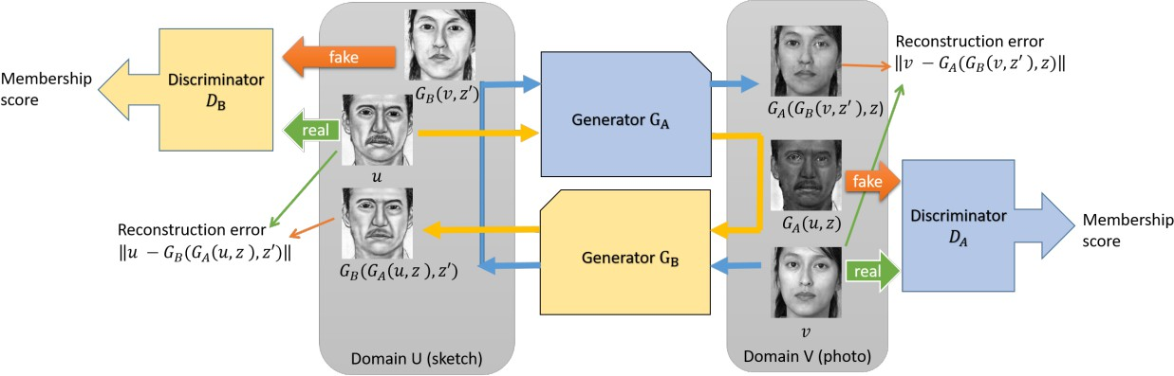
Network Architecture for DualGAN

Slide 19
DualGAN consists of two generators and two discriminators, one pair for each direction:
Generators
  G_{AB}​: maps images from Domain A to Domain B (A→B).
  G_{BA}​: maps images from Domain B to Domain A (B→A).
Discriminators
  D_{A}​: distinguishes real images in Domain A from fake images produced by G_{BA} ​.
  D_{B}: distinguishes real images in Domain B from fake images produced by G_{AB}.

Slide 20
Two-Phase Training Procedure
Supervised warm-start Phase
The model is first trained with paired samples (a, b) where a ∈ A and b ∈ B.
Generators G_{AB}​ and G_{BA} ​earn direct mappings between domains using exact correspondences.
Discriminators D_{A} and D_{B} learn to distinguish real images from those produced by the generators in their respective domains.

Slide 21
Transition Step
Training is monitored using an iteration counter or epoch index.
Once the predefined transition epoch k is reached, the data loader is switched from paired training samples to unpaired samples.

Slide 22
Unsupervised Phase
In the second phase, the model is trained on unpaired samples from Domains A and B.
Generators G_{AB} and G_{BA} adapt to translate images without explicit one-to-one correspondences.
Discriminators D_{A} and D_{B} refine their decision boundaries based on a wider variety of inputs.
Training now relies purely on adversarial and cycle-consistency losses, as in the original DualGAN framework.
After both phases, the resulting DualGAN model integrates information learned from paired and unpaired data and can translate images between Domains A and B in both directions, even when direct pairings are not available at test time.

Slide 23
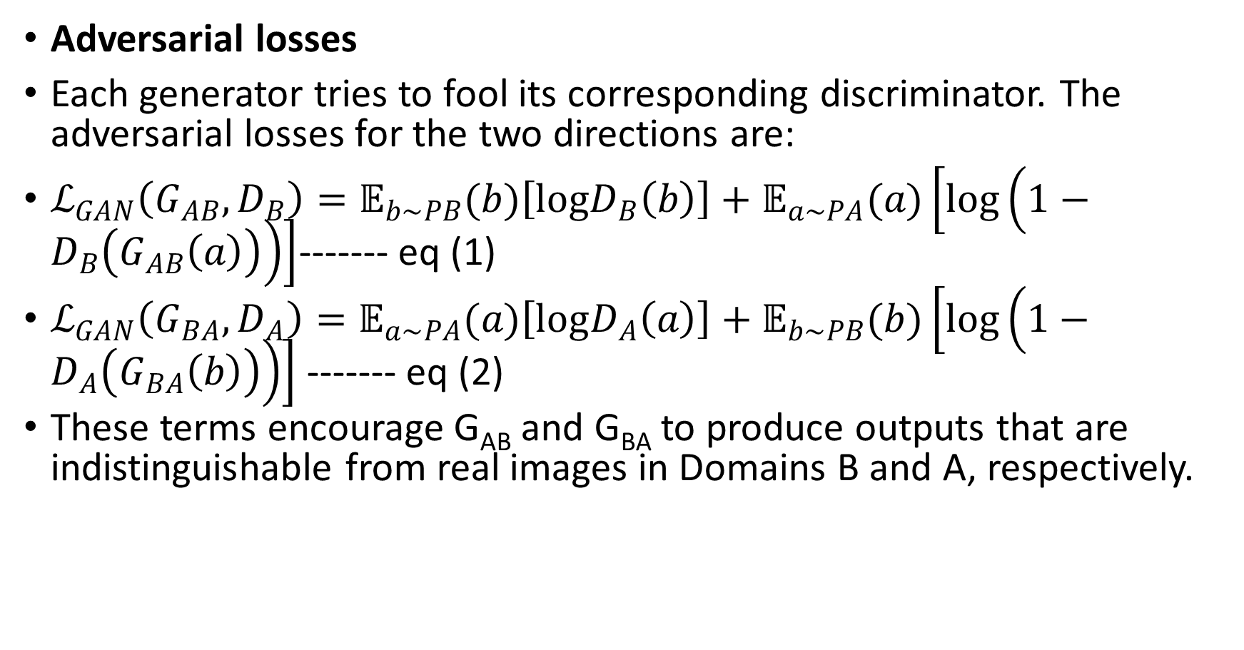
Mathematical Formulation
Adversarial losses
Each generator tries to fool its corresponding discriminator. The adversarial losses for the two directions are:
$ℒ_{GAN}\left(G_{AB},D_{B}\right)=𝔼_{b\sim PB}(b)\left[logD_{B}\left(b\right)\right]+𝔼_{a\sim PA}(a)\left[log\left(1−D_{B}\left(G_{AB}\left(a\right)\right)\right)\right]$------- eq (1)
$ℒ_{GAN}\left(G_{BA},D_{A}\right)=𝔼_{a\sim PA}(a)\left[logD_{A}\left(a\right)\right]+𝔼_{b\sim PB}(b)\left[log\left(1−D_{A}\left(G_{BA}\left(b\right)\right)\right)\right]$ ------- eq (2)
These terms encourage G_{AB} and G_{BA} to produce outputs that are indistinguishable from real images in Domains B and A, respectively.

Slide 24
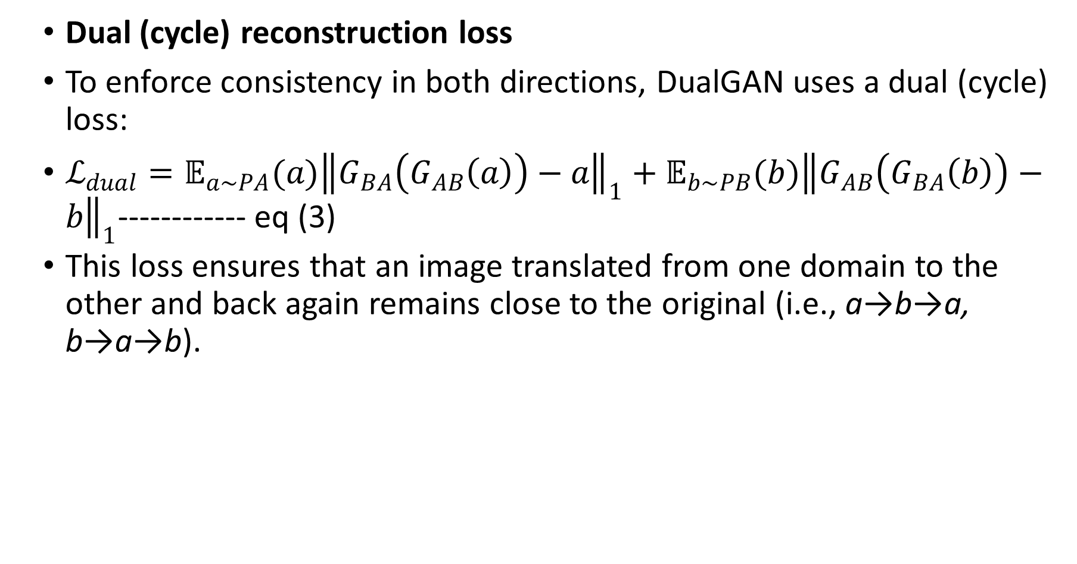
Dual (cycle) reconstruction loss
To enforce consistency in both directions, DualGAN uses a dual (cycle) loss:
$ℒ_{dual}=𝔼_{a\sim PA}(a){\left\|G_{BA}\left(G_{AB}\left(a\right)\right)−a\right\|}_{1}+𝔼_{b\sim PB}(b){\left\|G_{AB}\left(G_{BA}\left(b\right)\right)−b\right\|}_{1}$------------ eq (3)
This loss ensures that an image translated from one domain to the other and back again remains close to the original (i.e., a→b→a, b→a→b).

Slide 25
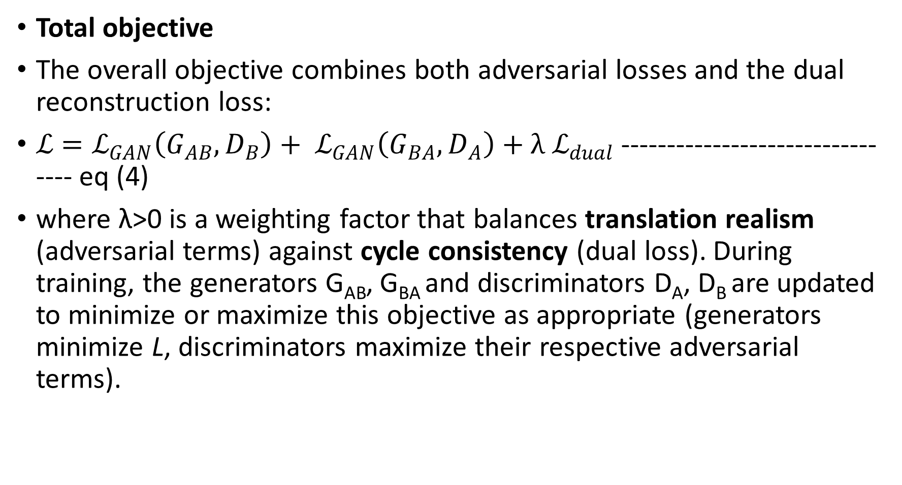
Total objective
The overall objective combines both adversarial losses and the dual reconstruction loss:
$ℒ=ℒ_{GAN}\left(G_{AB},D_{B}\right)+ ℒ_{GAN}\left(G_{BA},D_{A}\right)+{λ ℒ}_{dual}$ -------------------------------- eq (4)
where λ>0 is a weighting factor that balances translation realism (adversarial terms) against cycle consistency (dual loss). During training, the generators G_{AB}, G_{BA} and discriminators D_{A}, D_{B} are updated to minimize or maximize this objective as appropriate (generators minimize L, discriminators maximize their respective adversarial terms).

Slide 26
Hyperparameter Tuning
batch size and number of critic steps (n_{critic}​)
learning rate and optimizer settings
cycle-loss weight λ (and, if applicable, separate λ_{A}​ and λ_{B})
warm-start transition epoch k
effective data size and dropout rate
Candidate configurations are evaluated on a validation subset using MSE, SSIM, and FID, and the best-performing setting is carried forward to final training and testing

Slide 27
Performance/Evaluation Metrics
Mean Squared Error (MSE): measures pixel-wise reconstruction error between translated images and their ground-truth targets.
Structural Similarity Index (SSIM): measures perceptual similarity by comparing luminance, contrast, and structural information.
Fréchet Inception Distance (FID): assesses the realism and distributional alignment of generated images relative to real images in a deep feature space.

Slide 28
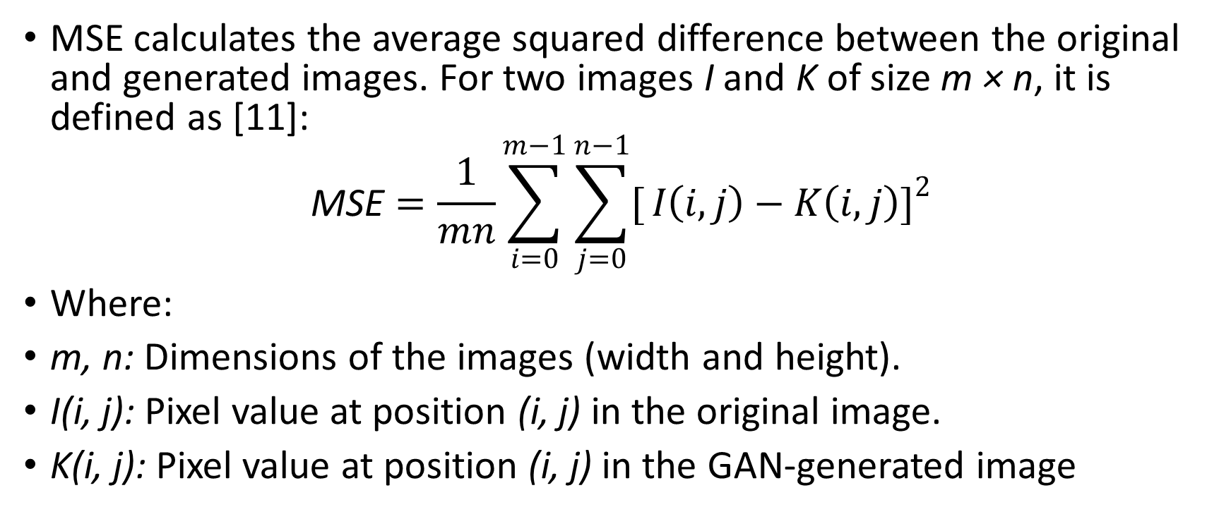
Mean Square Error (MSE)
MSE calculates the average squared difference between the original and generated images. For two images I and K of size m × n, it is defined as [11]:
$$\text{MSE}=\frac{1}{mn}\sum_{i=0}^{m−1}{\sum_{j=0}^{n−1}{[}}I\left(i,j\right)−K\left(i,j\right)]^{2}$$
Where:
m, n: Dimensions of the images (width and height).
I(i, j): Pixel value at position (i, j) in the original image.
K(i, j): Pixel value at position (i, j) in the GAN-generated image

Slide 29
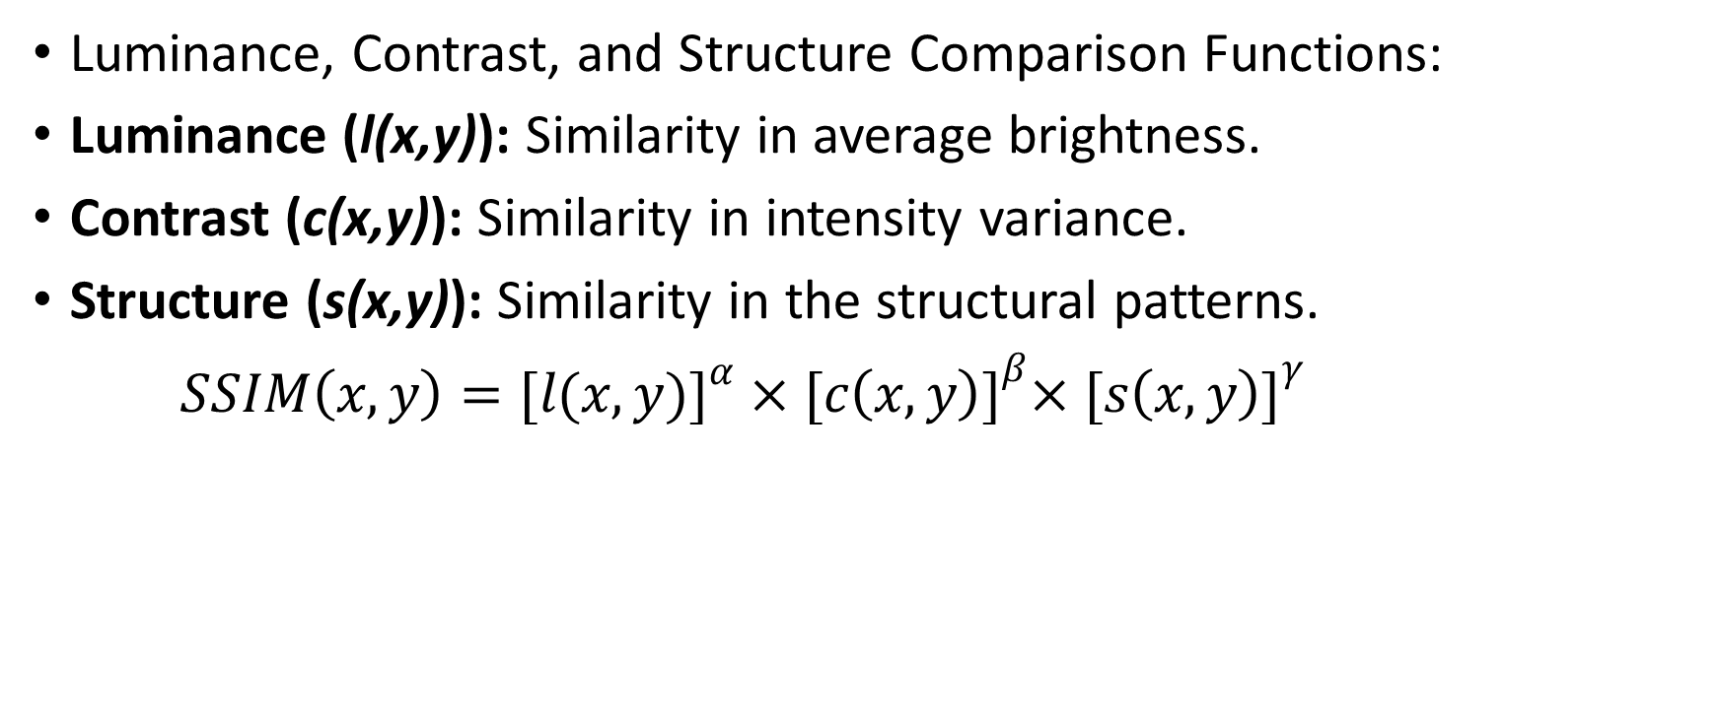
Structural Similarity Index (SSIM)
Luminance, Contrast, and Structure Comparison Functions:
Luminance (l(x,y)): Similarity in average brightness.
Contrast (c(x,y)): Similarity in intensity variance.
Structure (s(x,y)): Similarity in the structural patterns.
$SSIM\left(x,y\right)=[{l(x, y)]}^{α}×{[c\left(x, y\right)]}^{β}×{[s\left(x, y\right)]}^{γ}$

Slide 30
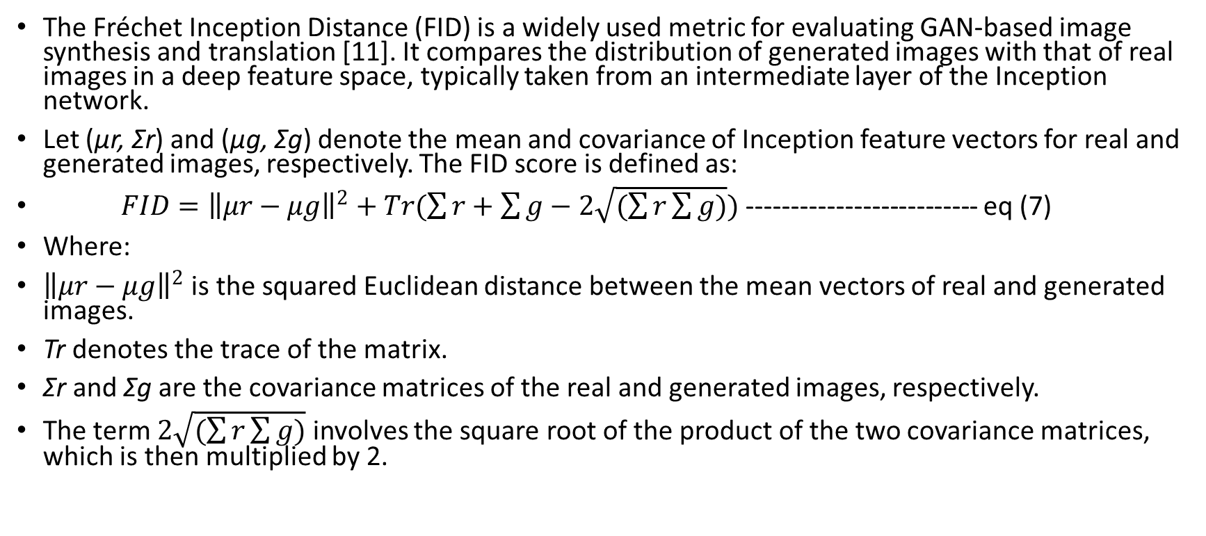
Frechet Inception Distance (FID)
The Fréchet Inception Distance (FID) is a widely used metric for evaluating GAN-based image synthesis and translation [11]. It compares the distribution of generated images with that of real images in a deep feature space, typically taken from an intermediate layer of the Inception network.
Let (µr, Σr) and (µg, Σg) denote the mean and covariance of Inception feature vectors for real and generated images, respectively. The FID score is defined as:
$FID={\left\|μr−μg\right\|}^{2}+Tr(\sum{r}+\sum{g−2\sqrt{(\sum{r}\sum{g})}})$ -------------------------- eq (7)
Where:
${\left\|μr−μg\right\|}^{2}$ is the squared Euclidean distance between the mean vectors of real and generated images.
Tr denotes the trace of the matrix.
Σr and Σg are the covariance matrices of the real and generated images, respectively.
The term $2\sqrt{(\sum{r}\sum{g})}$ involves the square root of the product of the two covariance matrices, which is then multiplied by 2.

Slide 31
IMPLEMENTATION
Tools and Techniques
The proposed Warm-Start DualGAN was implemented in Google Colab Pro to leverage managed GPU acceleration and a reproducible, shareable runtime.
Hardware Specifications:
GPU Accelerator: NVIDIA T4 with 15 GB VRAM (enabled for TensorFlow GPU operations)
System RAM: 12.7 GB
Storage: 235 GB temporary SSD (for datasets, caches, and checkpointing)

Slide 32
Software and Libraries:
Language: Python 3.12
DL framework: TensorFlow 2.x (GPU) for model definition, training loops, and mixed-precision when applicable
Data utilities: NumPy (tensor ops), Pandas (metadata/splits), OpenCV (image I/O & resize)
Monitoring & visuals: Matplotlib (loss plots, grids), TensorBoard (scalars, images, checkpoints)
Optimization: Adam (β₁=0.5, β₂=0.999); optional gradient-penalty when using a Wasserstein objective
Colab runtimes were configured with CUDA-compatible TensorFlow wheels and pip-installed dependencies directly in the notebook.

Slide 33
Implementation Details
The implementation was carried out in Google Colab notebooks using TensorFlow's Keras API for simplicity.
The original DualGAN architecture [1] was used without extensions: U-Net generators with skip connections for image translation, and PatchGAN discriminators to classify 70×70 patches as real or fake.
Data loading used glob and OpenCV to read images from mounted Google Drive folders. For Day-Night, images were resized from 512×512; for Facades, from 256×256. Paired samples were used fully in the warm-start phase (90 for Day-Night, 36 subsets for Facades), while unpaired samples (80 for Day-Night, 400 for Facades) were used in the continuation phase. The transition occurred after a fixed number of epochs (5 for Day-Night, 10 for Facades), with no loss deactivation or architectural change—only the data loader was switched.

Slide 34
Hyperparameters were set based on the original DualGAN paper [1] and empirical testing on validation data (10% holdout).
Parameter | Value
Batch Size | 1
n_critic | 5
Lambda_A | 1000
Lambda_B | 1000
Learning Rate | 0.0002
Optimizer | Adam (β1=0.5, β2=0.999)
Image Size | 256×256
Warm-Start Epochs | 5 (Day-Night), 10 (Facades)
Total Epochs | 30

Slide 35
Result and Analysis
Finding and Observations
This section summarizes quantitative outcomes and qualitative behaviors of the proposed Warm-Start DualGAN versus vanilla DualGAN on Facades and Day-Night. We report FID (lower the better), SSIM (higher the better), MSE (lower the better) and analyze epoch-wise loss trends.

Slide 36
Facades - test metrics (n = 100 images, mean ± sd)
Method | MSE | SSIM | FID
DualGAN + Warm-Start | 14097.72 ± 3208.14 | 0.1384 ± 0.0862 | 190.96
DualGAN (baseline) | 9526.26 ± 3231.86 | 0.1557 ± 0.0583 | 282.46

Slide 37
Day-Night - validation metrics (n = 10 pairs, mean ± sd).
Method | MSE | SSIM | FID
DualGAN + Warm-Start | 6039.97 ± 2579.15 | 0.2121 ± 0.0732 | 386.89
DualGAN (baseline) | 5532.66 ± 2804.17 | 0.0793 ± 0.0388 | 421.12

Slide 38
Interpretation. Across tasks, Warm-Start consistently improves distributional realism (lower FID). On Day-Night it also improves perceptual structure (SSIM), while Facades exhibits a perceptual-vs-pixel trade-off typical for GANs that prioritize texture plausibility.

Slide 39
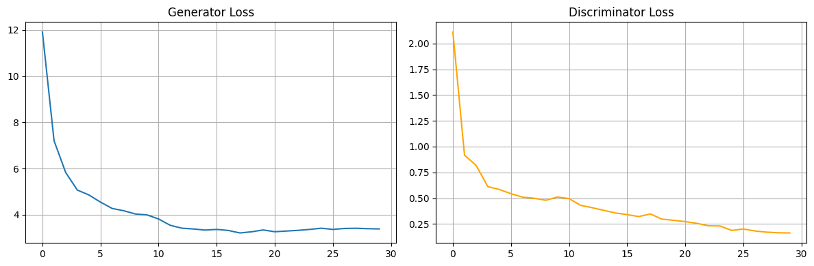
Training dynamics (epoch analysis)
Facades - Warm-Start: Phase-1 rapidly reduces G from 11.91→3.99 and D from 2.11→0.51; after switching to unpaired data, G stabilizes near 3.2–3.4 and D reaches ≈0.16 by total epoch 30, no transition shock.

Slide 40
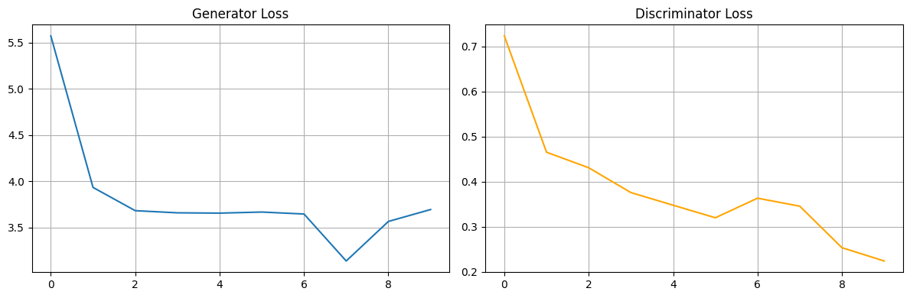
Facades – Baseline: Pure unpaired training reduces G 5.57→3.69 and D 0.72→0.22 over 10 epochs.

Slide 41
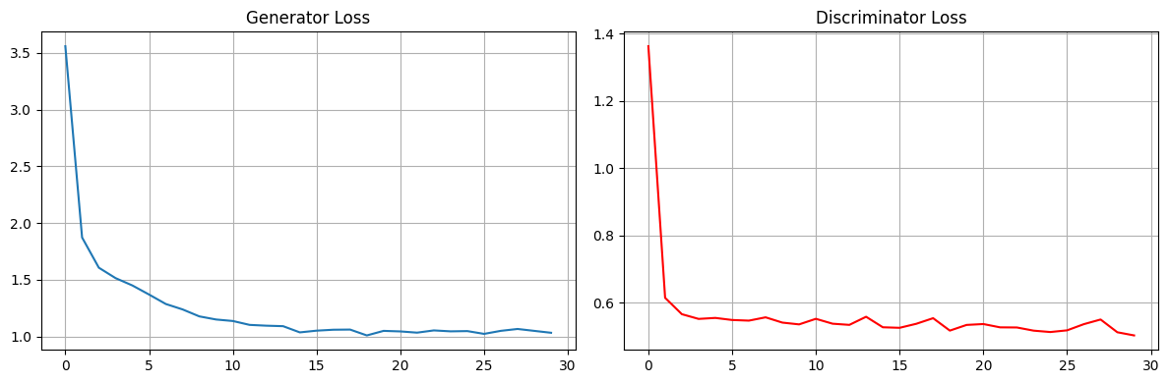
Day-Night - Warm-Start: Phase-1 aligns the mapping (G 3.56→1.45, D 1.36→0.56 across 5 warm epochs), then continuation gradually brings G ≈1.03–1.07 with D ≈0.50–0.56.

Slide 42
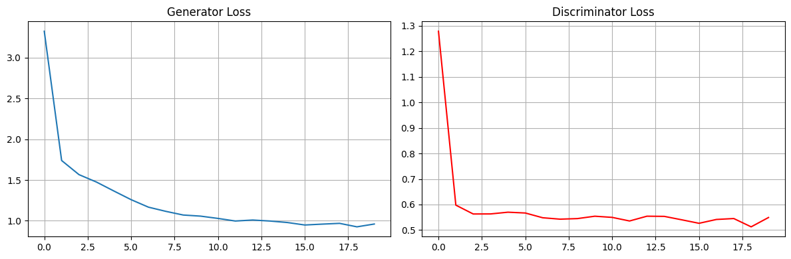
Day-Night – Baseline: G 3.33→0.96 with D ≈0.51–0.56 over 20 epochs.
Warm-Start gives faster early coherence and a stable transition when the data loader switches from paired to unpaired while keeping optimizer state fixed; consistent with the observed FID/SSIM gains.

Slide 43
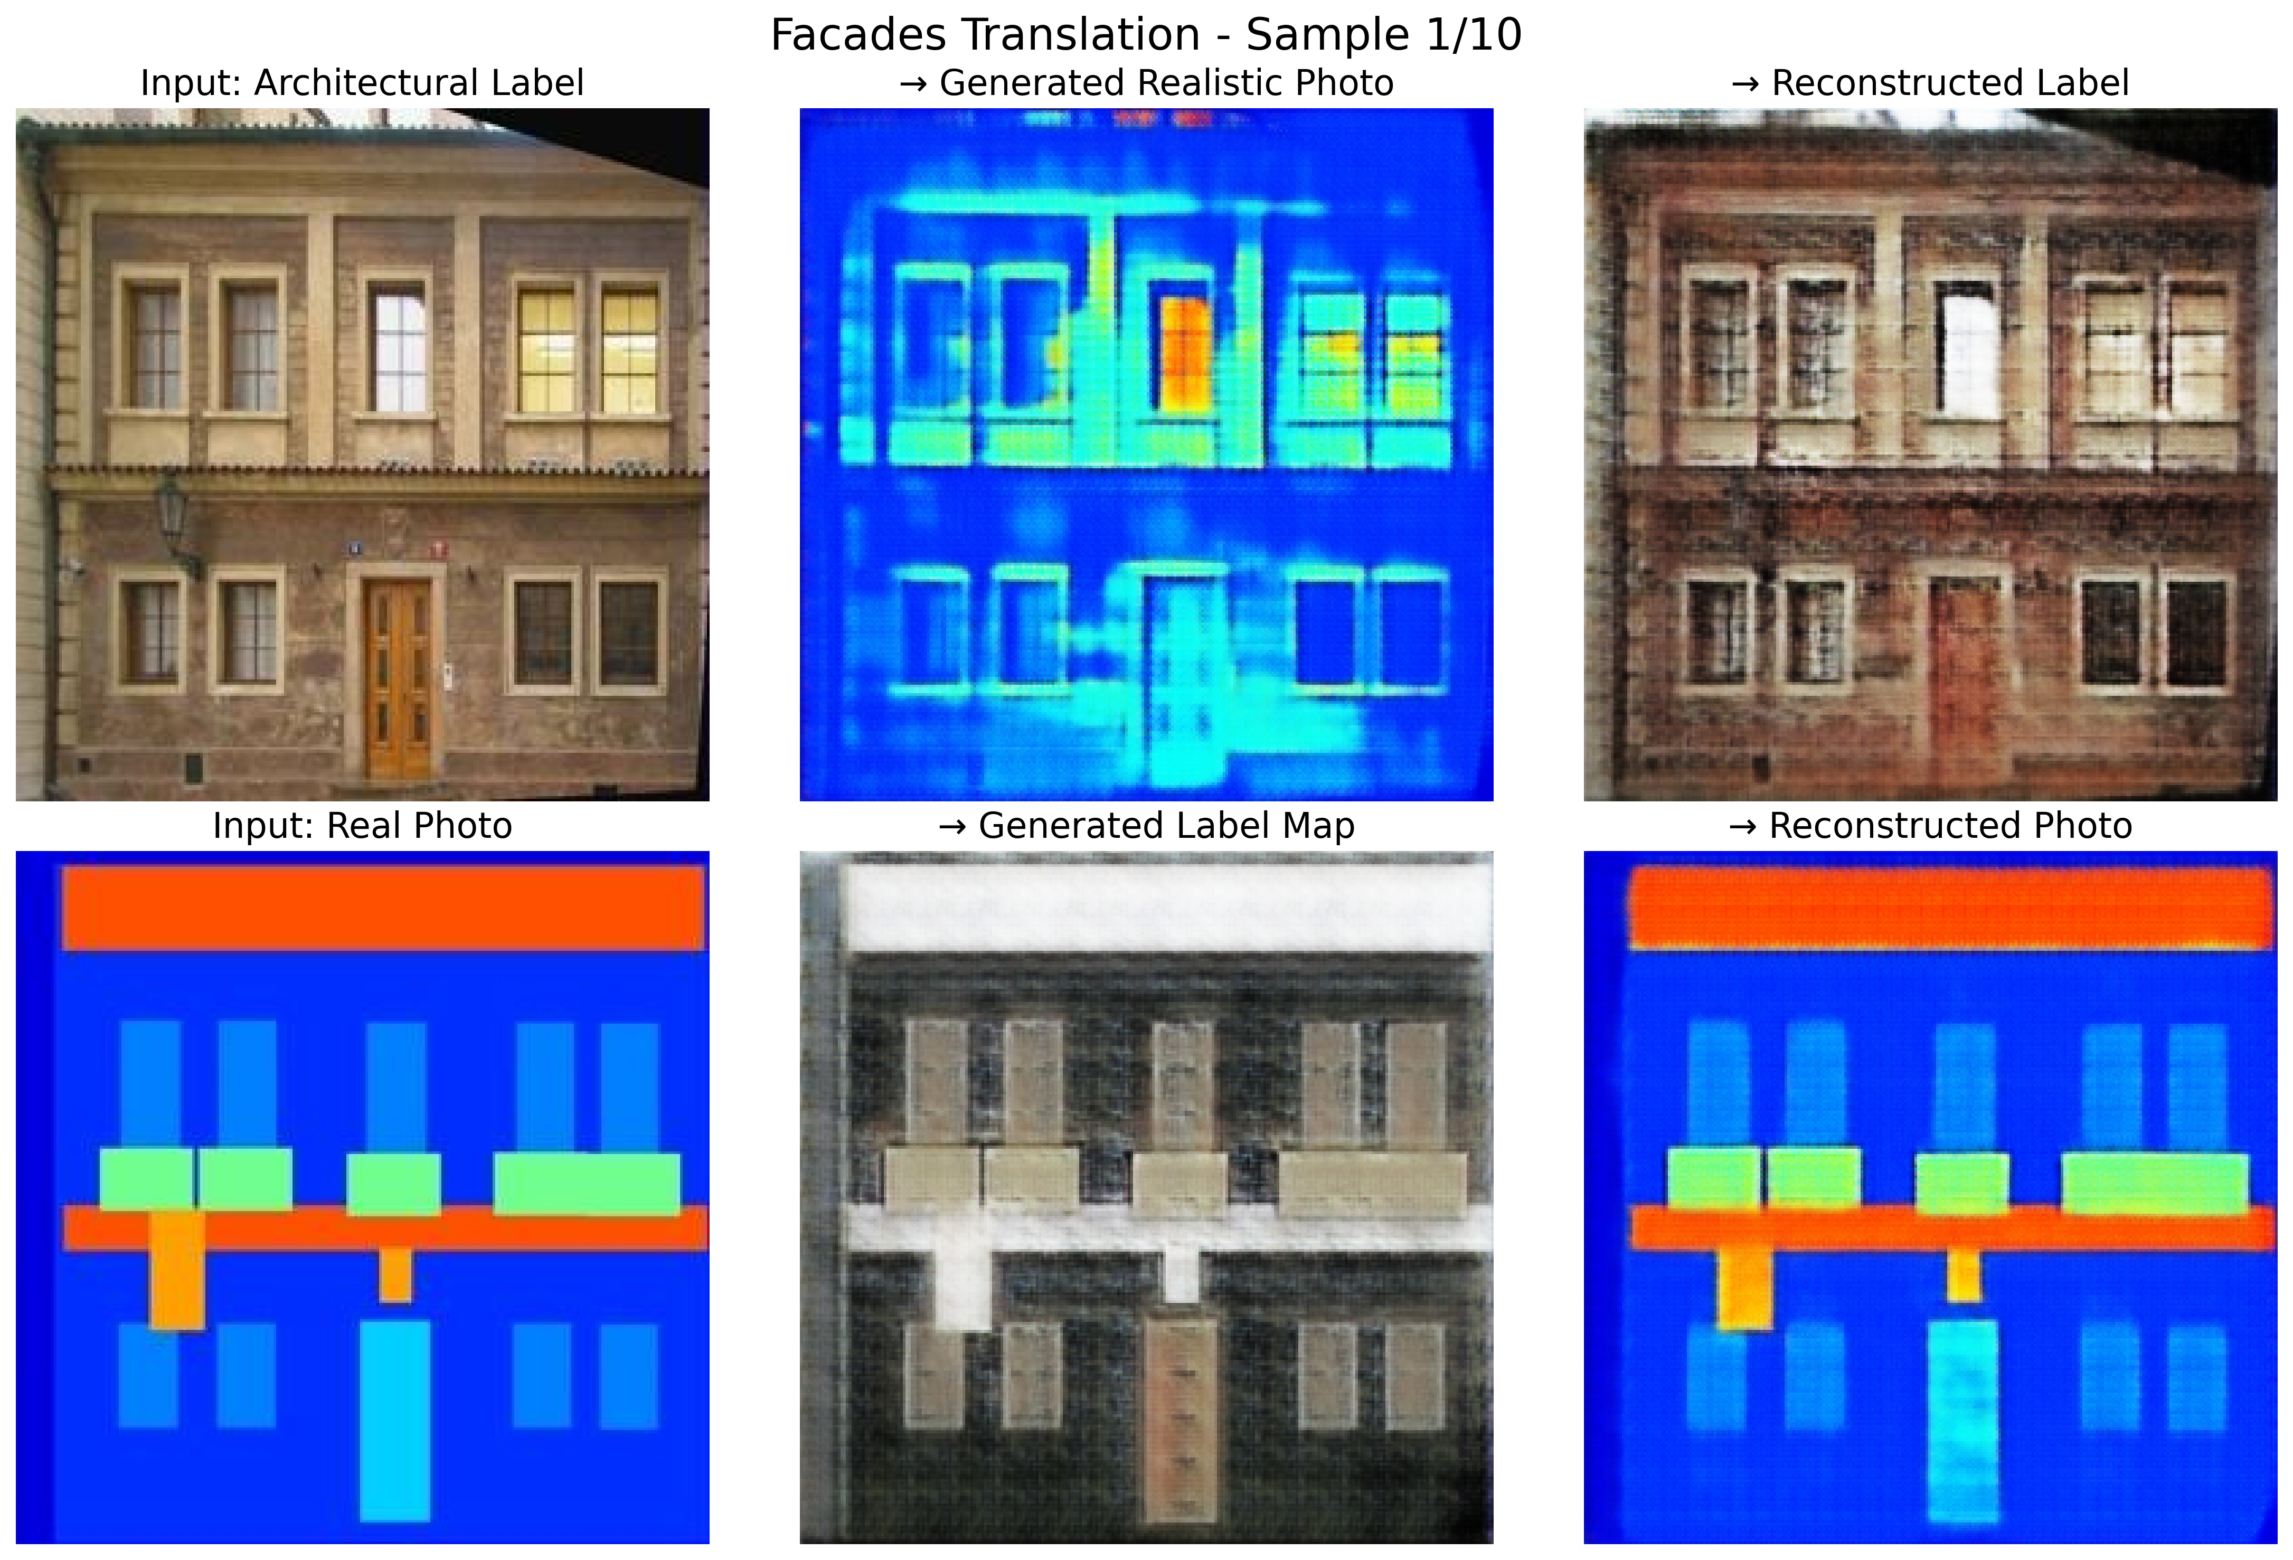
Qualitative observations (visual evidence)
Facades: Warm-Start produces more natural facade textures (bricks/plaster) with fewer synthetic patterns, whereas the baseline adheres more tightly to pixel correspondences; hence better MSE/SSIM but worse FID.

Slide 44
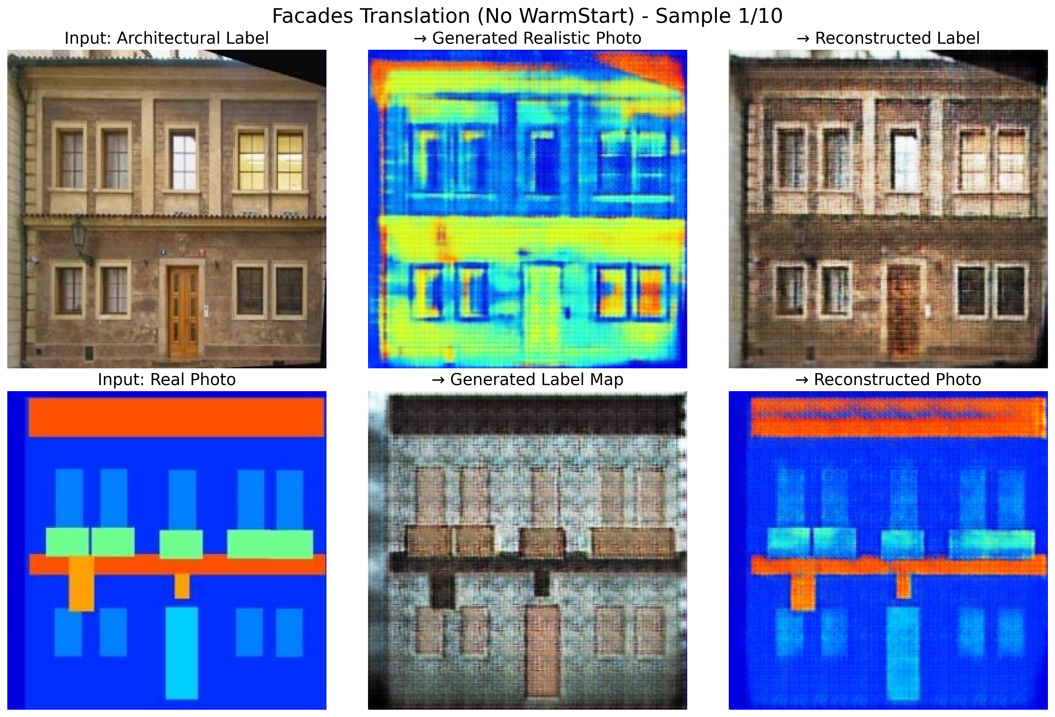
Qualitative translation results on Facades (Baseline).

Slide 45
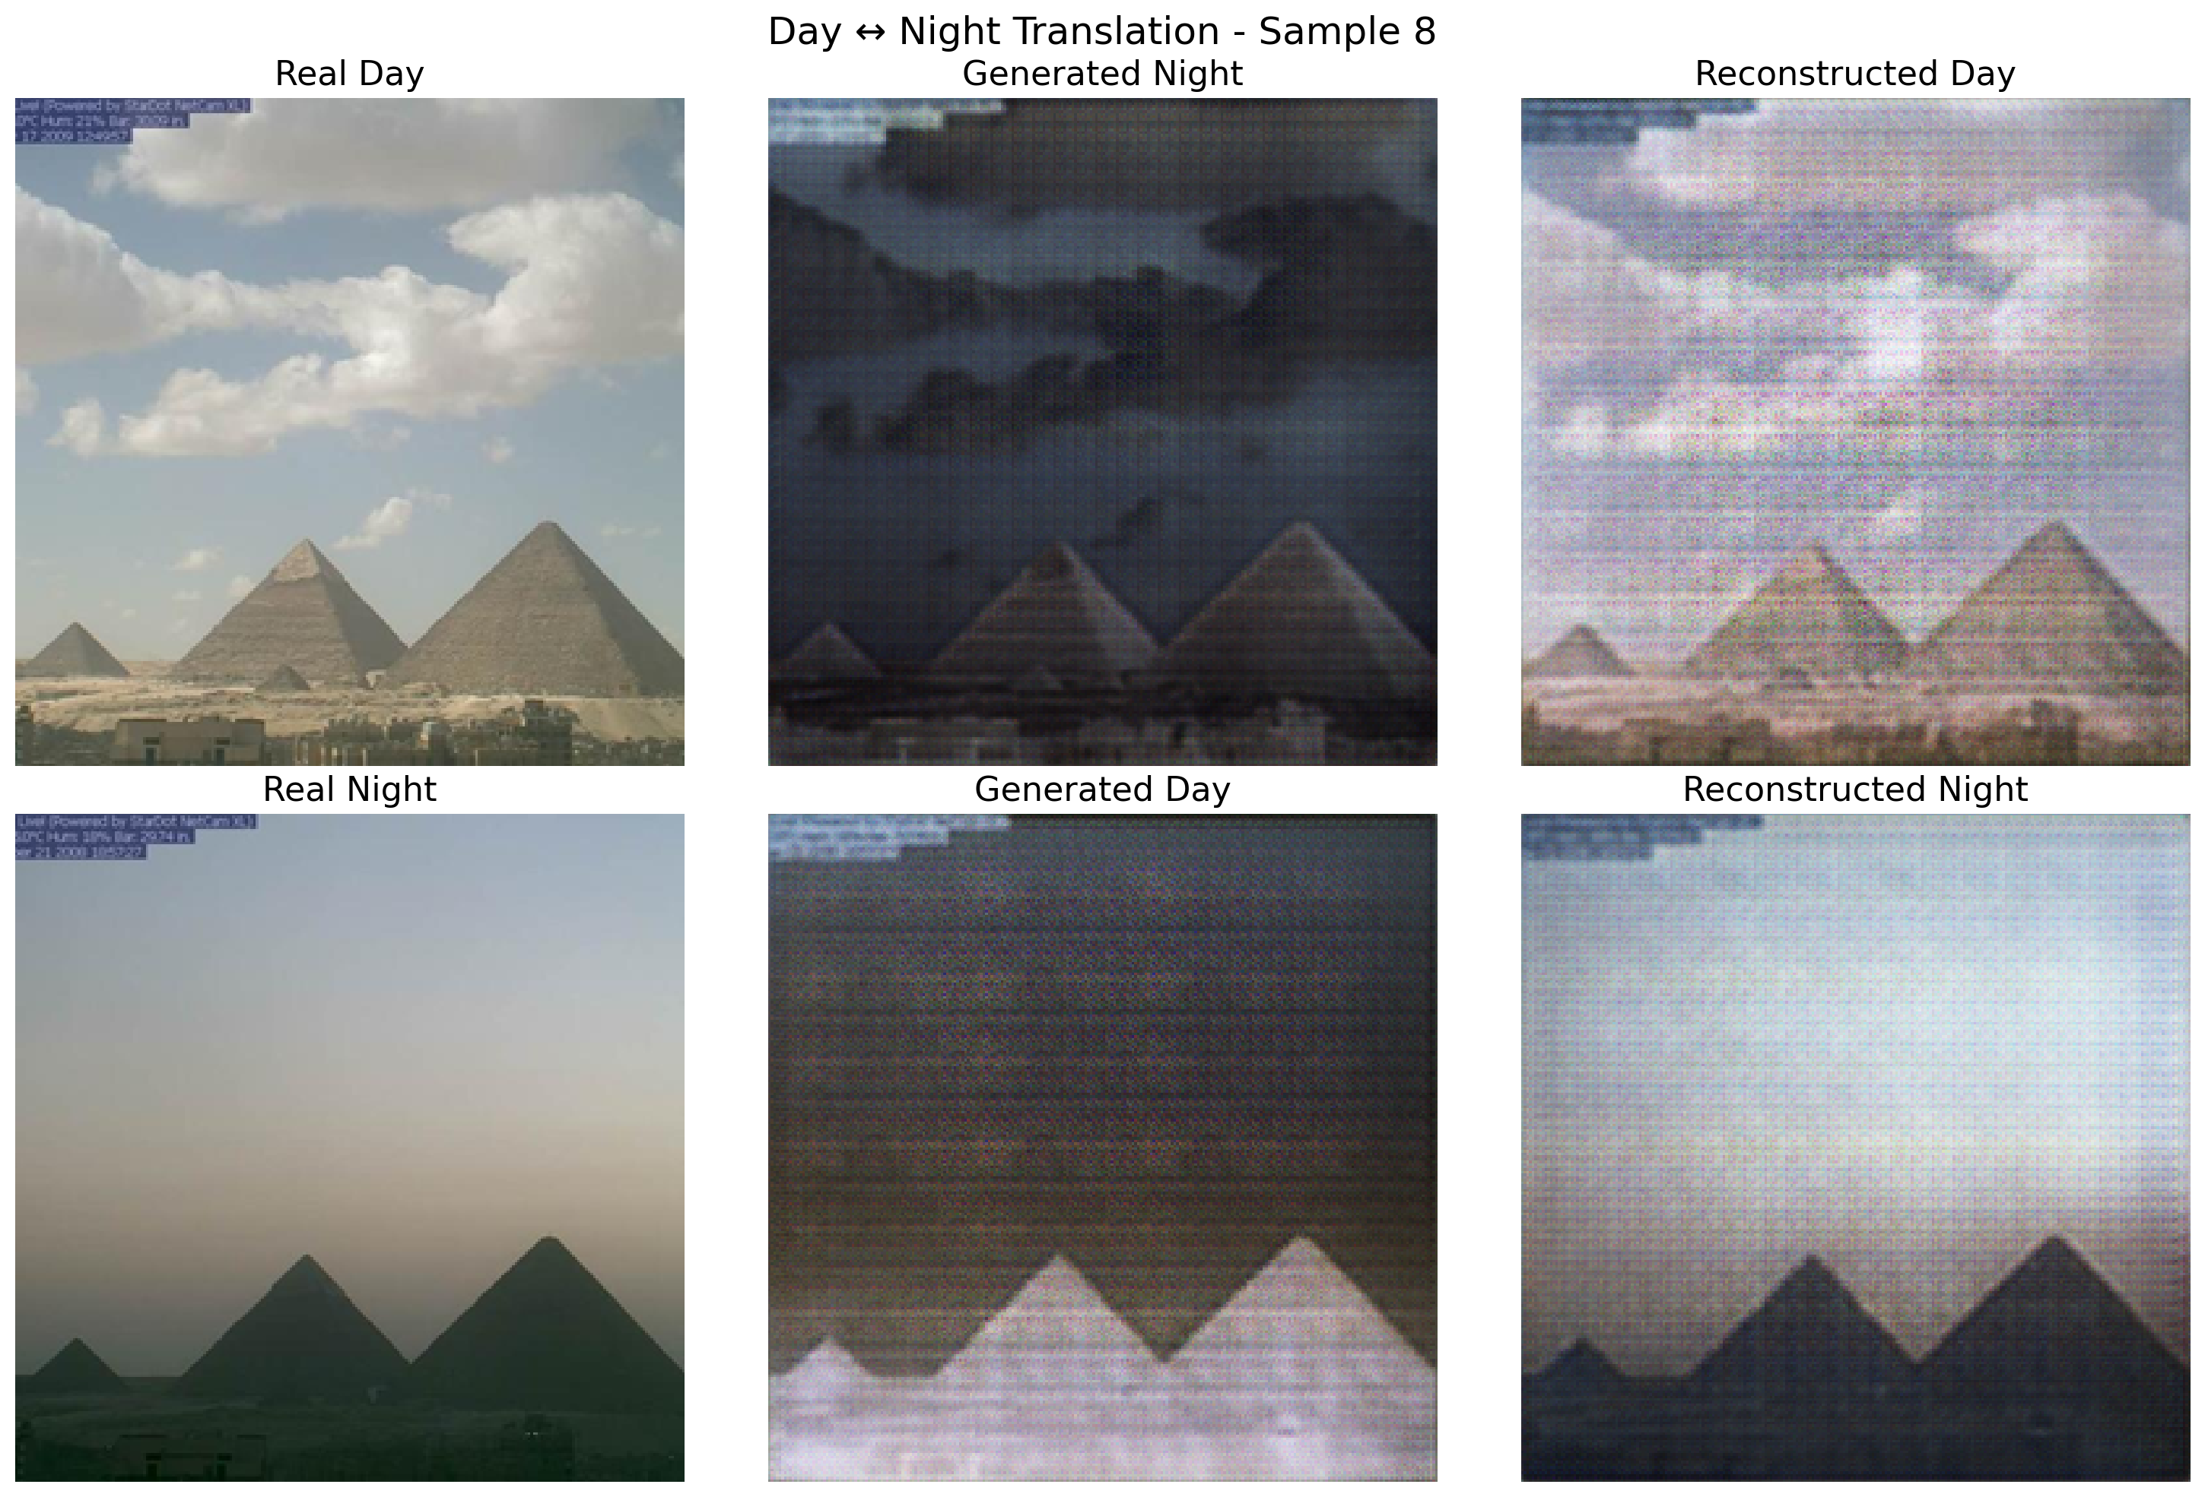
Qualitative translation results on Day-Night(Warm Start)

Slide 46
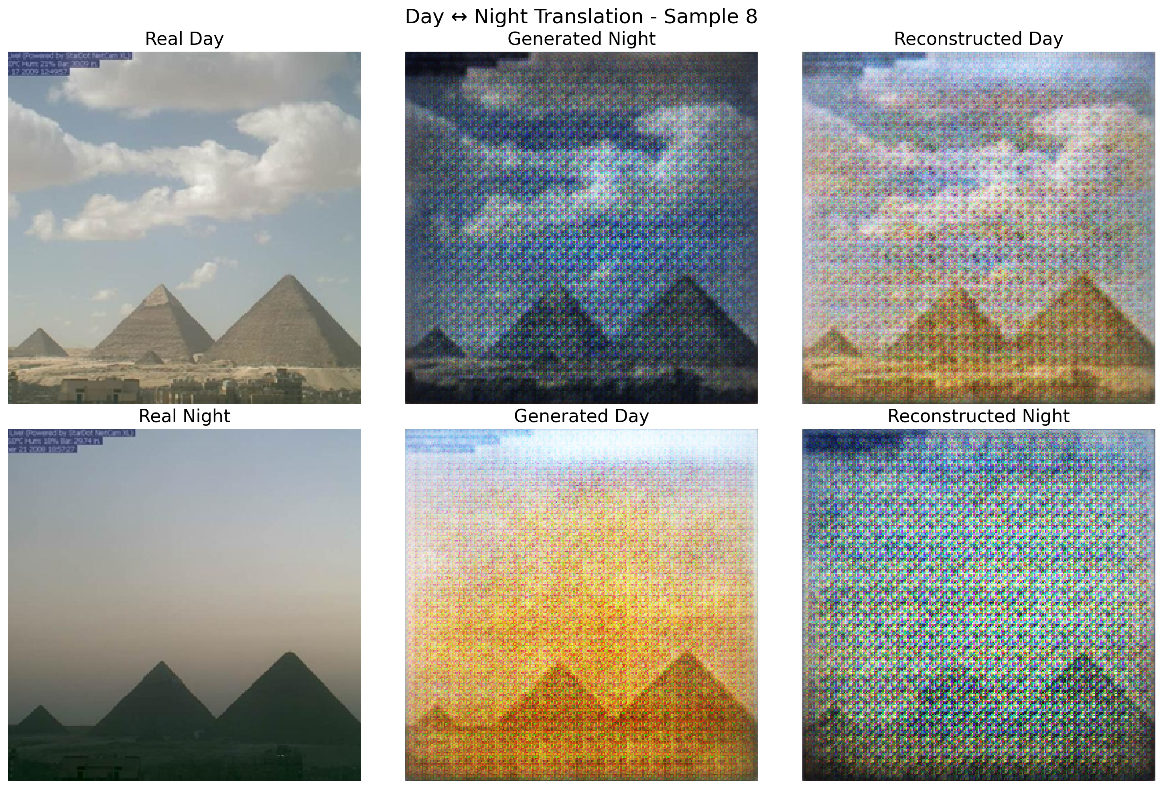
Qualitative translation results on Day-Night(Baseline)
Day-Night: Warm-Start reduces haloing around light sources, preserves sky/ground separation, and avoids over-darkening/over-brightening reflected by its SSIM and FID improvements.

Slide 47
Result Analysis
This section critically interprets the findings, examines trade-offs, and offers dataset-specific insights plus practical guidance.

Slide 48
Comparative effectiveness
Distributional realism (FID): Warm-Start is superior on both tasks (190.96 vs 282.46 on Facades; 386.89 vs 421.12 on Day-Night), evidencing a generator distribution closer to real images after the two-phase schedule.
Perceptual structure (SSIM): The large Day-Night SSIM gain (0.2121 vs 0.0793) indicates that a short-supervised anchor helps retain scene layout under illumination shifts; the modest SSIM shortfall on Facades mirrors the task’s emphasis on pixel-accurate semantics.
Pixel agreement (MSE): Baseline wins on MSE, especially on Facades. This is expected: after warm-starting, adversarial pressure on unpaired data favors plausible textures over exact pixel matching; hence lower FID but not necessarily lower MSE.

Slide 49
Why the trade-off appears (mechanistic view)
Phase-1 teaches a semantic alignment (paired supervision).
Phase-2 (unpaired) optimizes adversarial + cycle losses, which bias the generator toward distributional plausibility; this improves FID (and often SSIM in illumination tasks) while relaxing per-pixel fidelity, particularly where label→photo textures are ambiguous (Facades).

Slide 50
Sensitivity to schedule and weights (evidence-based guidance)
Short k ∈ {3, 5} for Day-Night avoids overfitting tiny pairs yet delivers strong SSIM/FID gains.
Moderate k ∈ {10, 15} for Facades helps lock geometry (windows/doors), but too large k may soften edges; the run used 10 warm epochs with stable hand-off.
Cycle-loss weight λ: higher values preserve structure but may mute textures; tune to balance SSIM/MSE vs FID per dataset.
Batch & memory: at 256*256 on T4, batch 1–4 is stable, the logs show Discriminator staying near 0.5–0.56, a healthy adversarial regime

Slide 51
Error analysis and remedies
Boundary bleeding (Facades): windows/rails merge with walls at oblique lighting. Mitigation: include identity loss during Phase-1, moderate λ, consider multi-scale discriminators.
Low-light speckle (Night): speckle in sky regions. Mitigation: brief identity/perceptual regularization early, light denoising prior.
Fine texture loss (<16 pixel): distant signage/hairline trims. Mitigation: adjust PatchGAN receptive field or add a small multi-scale critic.

Slide 52
Efficiency and stability
Transition stability: Both datasets show no loss spikes at the switch (paired→unpaired); Generator plateaus while Discriminator declines smoothly—evidence that keeping optimizer state/hyperparameters fixed is critical.
Practical benefit: Warm-Start reduces the time-to-coherent outputs (fewer unproductive early epochs), especially on Day-Night.

Slide 53
Overall conclusion of Result and Analysis
Warm-Start DualGAN is a practical, compute-neutral enhancement: strong FID improvements on both tasks and SSIM gains where, paired data are scarce (Day↔Night), with an understandable and tunable pixel-level trade-off on Facades. Choosing short k for scarce pairs and moderate λ generally yields the best balance.

Slide 54
Conclusion and Future Recommendations
Conclusion
This work demonstrated that a brief paired-data warm-start preceding original DualGAN training on unpaired data can improve generation quality without changing the model architecture or loss functions. The protocol uses the same adversarial and cycle-consistency objectives throughout; at epoch k the data loader alone is switched, while the network weights and optimizer state are preserved. Experiments on Facades and Day-Night show:
Distributional realism improves on both datasets (FID 282.46 → 190.96 on Facades; 421.12 → 386.89 on Day-Night).
Perceptual structure notably improves on Day-Night (SSIM 0.0793 → 0.2121), aligning with qualitative gains (reduced haloing, better sky/ground separation).
Pixel agreement (MSE/SSIM) can favor the baseline on Facades, reflecting the classic perceptual-vs-pixel trade-off when adversarial training prioritizes plausible textures.
Epoch-wise loss trajectories confirm stable convergence and a smooth transition at epoch k (no loss spikes), supporting the claim that warm-start accelerates early alignment while maintaining DualGAN’s unsupervised strengths. Consequently, warm-start is a practical, compute-neutral enhancement for domains with few pairs and many unpaired samples; its effect can be balanced via k and λ to target realism vs. pixel fidelity.

Slide 55
Future Recommendations
Future work could address the limitations observed:
Adaptive Warm-Start Duration: Dynamically determine the transition epoch k based on validation metrics or loss plateaus to mitigate overfitting risks.
Paired Data Augmentation: Incorporate synthetic pairs via techniques like data mixing or diffusion-based augmentation to increase the effective size of paired sets.
Advanced Regularization: Explore adding contrastive losses (e.g., from CUT) or self-supervised pretraining to make warm-start more robust on semantic tasks.
Broader Evaluation: Test on additional domains (e.g., horse↔zebra, medical imaging) and larger paired subsets to refine guidelines on when warm-start succeeds.
Scalability: Implement in PyTorch for easier extension and evaluate on high-resolution images with attention-based generators.

Slide 56
References
[1] Z. Yi, H. Zhang, P. Tan, and M. Gong, “DualGAN: Unsupervised Dual Learning for Image-to-Image Translation,” Proceedings of the IEEE International Conference on Computer Vision, Oct. 2017, doi: 10.1109/iccv.2017.310.
[2] P. Isola, J. Zhu, T. Zhou, and A. A. Efros, “Image-to-Image Translation with Conditional Adversarial Networks,” Proceedings of the IEEE Conference on Computer Vision and Pattern Recognition, Jul. 2017, doi: 10.1109/cvpr.2017.632.
[3] Y. Cao et al., “Recent advances of generative adversarial networks in computer vision,” IEEE Access, vol. 7, pp. 14985–15006, Jan. 2019, doi: 10.1109/access.2018.2886814.
[4] R. Tyleček and R. Šára, “Spatial Pattern Templates for Recognition of Objects with Regular Structure,” in Pattern Recognition, 2013, pp. 364–374. doi: 10.1007/978-3- 642-40602-7_39.
[5] P.-Y. Laffont, Z. Ren, X. Tao, C. Qian, and J. Hays, “Transient attributes for high- level understanding and editing of outdoor scenes,” ACM Transactions on Graphics, vol. 33, no. 4, pp. 1–11, Jul. 2014, doi: 10.1145/2601097.2601101.

Slide 57
References
[6] F. Wu and S. You, “Semi-supervised semantic segmentation via image-to-image translation,” Automatic Target Recognition XXXI, Apr. 2021, doi: 10.1117/12.2586052.
[7] R. Li, W. Cao, Q. Jiao, S. Wu, and H.-S. Wong, “Simplified unsupervised image translation for semantic segmentation adaptation,” Pattern Recognition, vol. 105, p. 107343, Sep. 2020, doi: 10.1016/j.patcog.2020.107343.
[8] A. Odena, “Semi-Supervised Learning with Generative Adversarial Networks,” arXiv (Cornell University), Jun. 2016, [Online]. Available: https://arxiv.org/pdf/1606.01583.pdf
[9] A. Creswell, T. White, V. Dumoulin, K. Arulkumaran, B. Sengupta, and A. A. Bharath, “Generative Adversarial Networks: An Overview,” IEEE Signal Processing Magazine, vol. 35, no. 1, pp. 53–65, Jan. 2018, doi: 10.1109/msp.2017.2765202.
[10] P. Roy, N. Häni, and V. Isler, “Semantics-Aware image to image translation and domain transfer,” arXiv (Cornell University), Apr. 2019, [Online]. Available: http://export.arxiv.org/pdf/1904.02203.
[11] M. Heusel, H. Ramsauer, T. Unterthiner, B. Nessler, and S. Hochreiter, “GANs trained by a two time-scale update rule converge to a local Nash equilibrium,” in Advances Neural Inf. Process. Syst. (NeurIPS), Long Beach, CA, USA, Dec. 2017, pp. 6626–6637.

Slide 58
Thank you!!!

